Slide 1

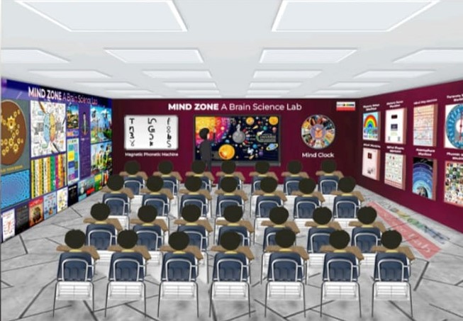
Brain science Laboratory

Slide 2

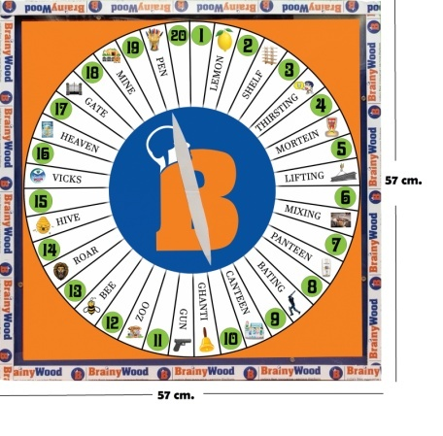
Instruments of Lab
Harmony Method Machine
Harmony method is numeric mnemonics
Useful for Point answers, sequence answer, chronological orders, random recalling at any point.
You will find the rhyming words of number 1 to 20 by practicing on board
E.g. Any question which is difficult to learn in points, long answer etc…

Slide 3
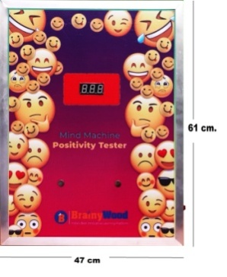
Positivity Tester Machine (Mind Machine)
Galvanic Resistance Several terms are used for this phenomena, such as EDA (electro dermal activity), EDR (electro dermal response)
You have to put your two fingers on specified button on board to know the mood your body generates heat and sweat ,according to your thoughts and state of mind
Positivity tester as per the readings on the display

Slide 4
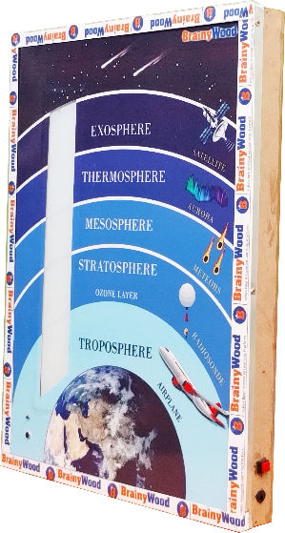
M4 Factor Machine
Chain method
Long answers , theory answer without points
Clap switch, sensors to operate the machine
Students learn Technology also

Slide 5
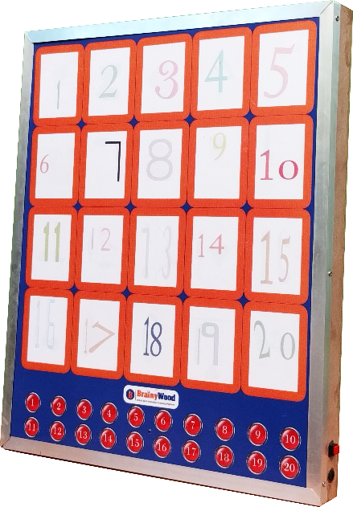
Figure and Feature Machine
Figure and feature Method
Point answer up to 20 points
Coordinate cards with the picture by practicing on board
Eg. Child labour Act, Community Helpers etc….

Slide 6
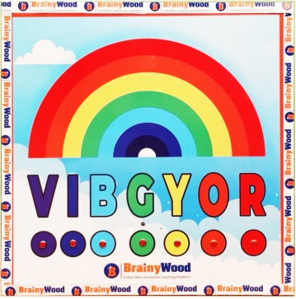
VIBGYOR Machine
VIBGYOR Method
E.g. Historical date, century and long answer question of History and Geography
Rainbow color sequence mapped with century years

Slide 7
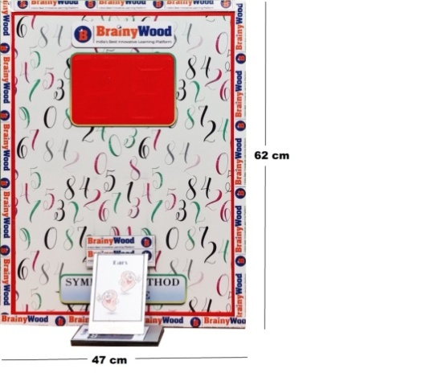
Symbolic method machine
Symbolic method from numeric mnemonics
Points answers, sequence in answer,
chronological order, random recalling at
any point
Sequence of images by Special Cards

Slide 8
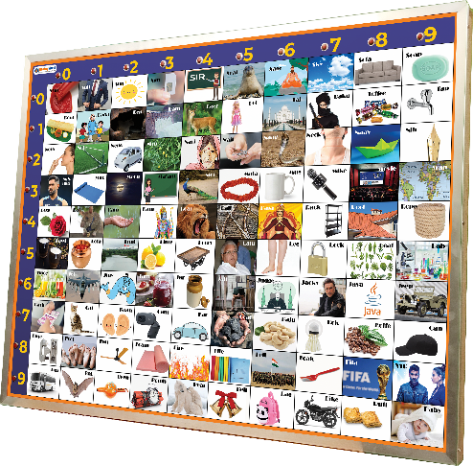
Phonic Method Machine
Phonetic method
Memorize phone number, math formula, table , historical date or other numbers Periodic Table
Practice to find the image of 01 to 99 number

Slide 9
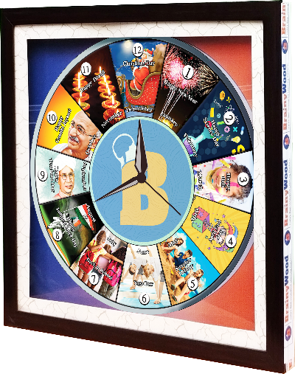
Mind Clock
Month code
Memorize month and events with help of phonetic and PIS method
12 month with associative images
General Knowledge and Current Affairs

Slide 10
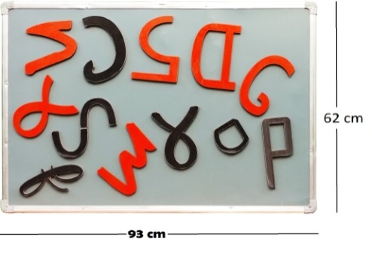
Magnetic Number Board
Phonetic code converter
Learn coding of phonetic method
Convert digit 0 to 9 in alphabetic code

Slide 11
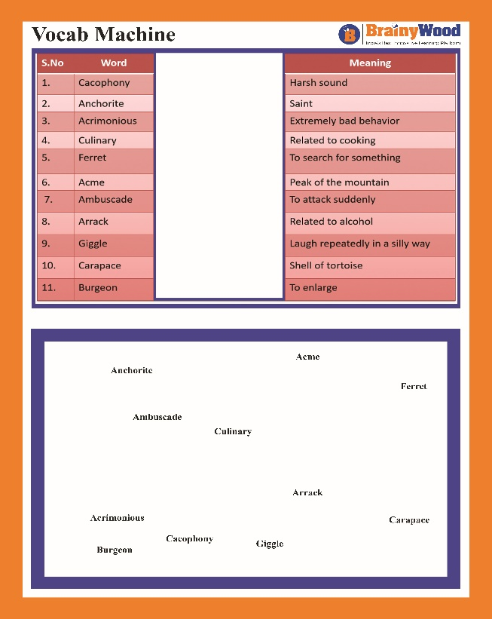
VOCAB Machine
PIS Method
Learn vocabulary, hard words and
word meaning, complete dictionary,
antonyms, synonyms etc…
Country/ Capital

Slide 12
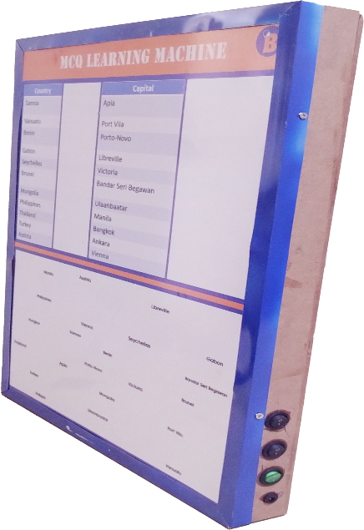
MCQ Machine
PIS Method
Learn short answer and MCQ
Basic GK/ Current Affairs
Gen Studies etc…

Slide 13
LAB SET UP
12 LAB Equipment
With Integrated K-12 Content
With Brainywood Brain Science Digital Content

